Slide 1
API Gateway An Introduction
August Duet @ Revature 7/01/2020

Slide 2
Overview
API Gateway is a means of routing traffic in a distributed system
API Gateway is used to simplify the client requests model
API Gateway provides a common interface for services to be leveraged by clients.
API Gateway == $$$$$

Slide 3
What API Gateway is not
API GATEWAYS ARE NOT LOAD BALANCERS!
Notes:
3 practical concepts of the API Gateway that I will cover are.
* Routing
* Interface
* Marketing

Slide 4
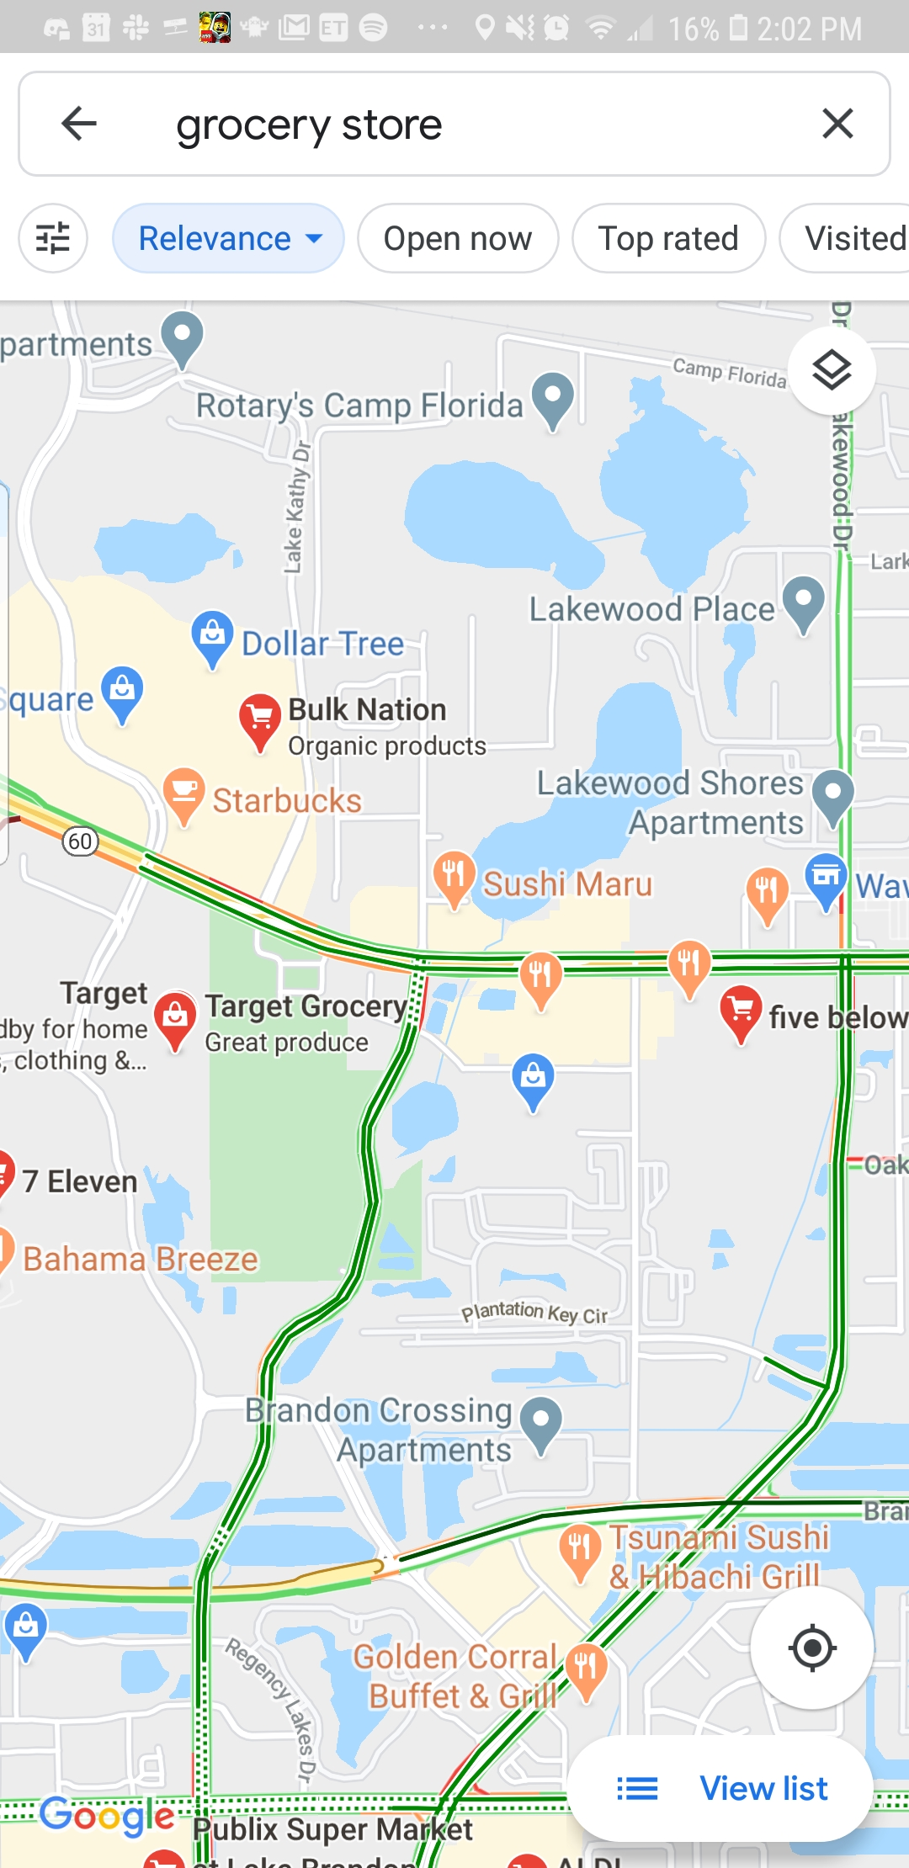
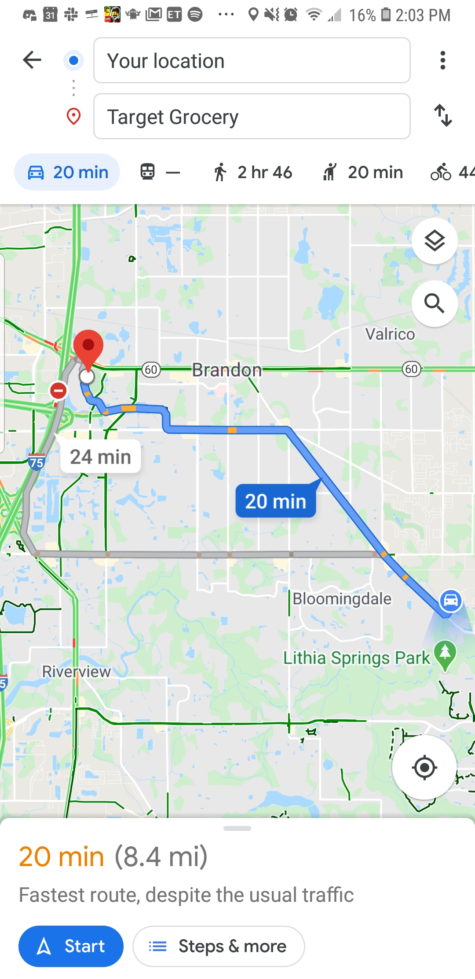
API Gateway (Routing)
Why do you use Google Maps?
FIND
NAVIGATE
Notes:
We use a service like Google Maps because often we don't know the extensive list of businesses in our area and often we don't know the most efficient way to navigate to those businesses. The API Gateway provides us with a way to find and navigate to individual services in the system.
1

Slide 5

API Gateway Routing (Find)
Notes:
API Gateway provides a function of finding services in distributed systems. Because distributed system have targets that are ephemeral in nature, it would be impossible for a client to know the exact location of the requests target (besides simply a name/url). Typically the find function can be configured in 1 of 2 ways.
* Hard coding
* Discovery Services
1

Slide 6
API Gateway Routing (Nav)
Notes:
Once the API Gateway uses it finding function it has the information to locate the service for the request. Clients can utilize the find and navigate functions of a gateway usually through some naming scheme typically DNS.
Routing is not load balancing. Routing may have some clientside load balancing included, but its not a guarantee in all Gateways
1

Slide 7
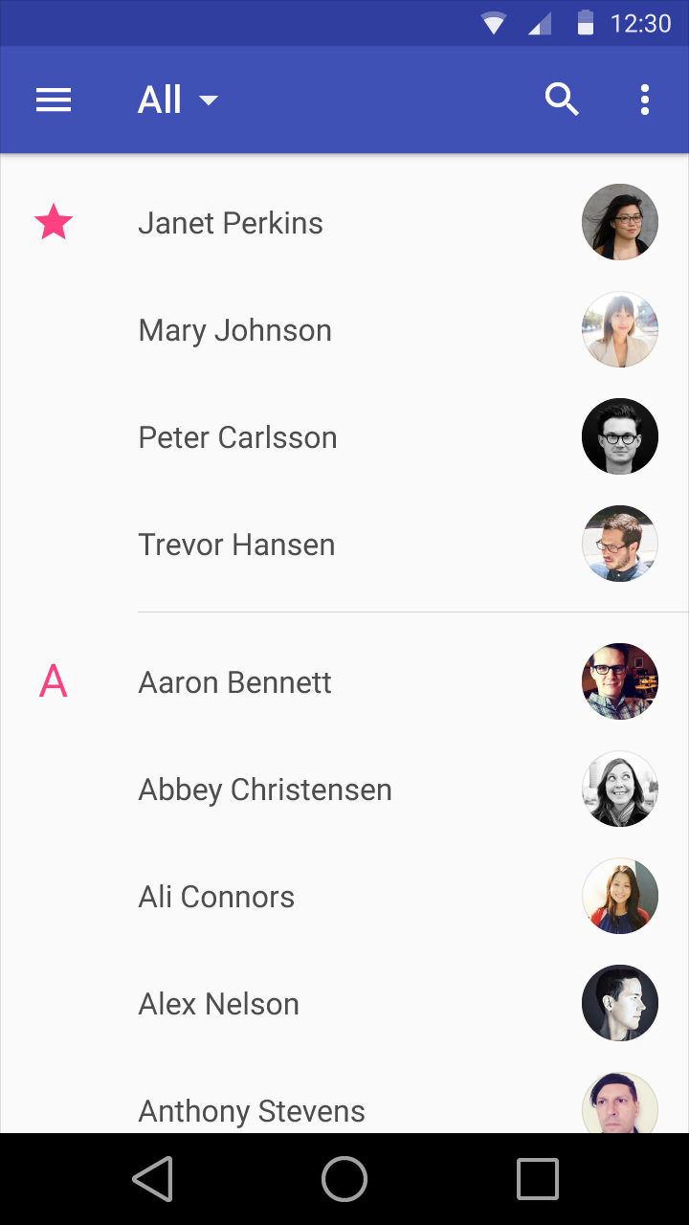
API Gateway (Interface)
Why do we use a contact list?
Lookup
Resolve
123-456-7890
Notes:
Ours phones contain a list of contacts because many of us don't want to have to remember the contact information of individuals in the our list. The contact list gives us all a common way of finding the contact information by a simple name.
API Gateway provides a common interface in this way. Contacting a service behind a Gateway can be achieved by simply knowing how the Gateway exposes it through its interface. Typically this is done through URLs
1

Slide 8
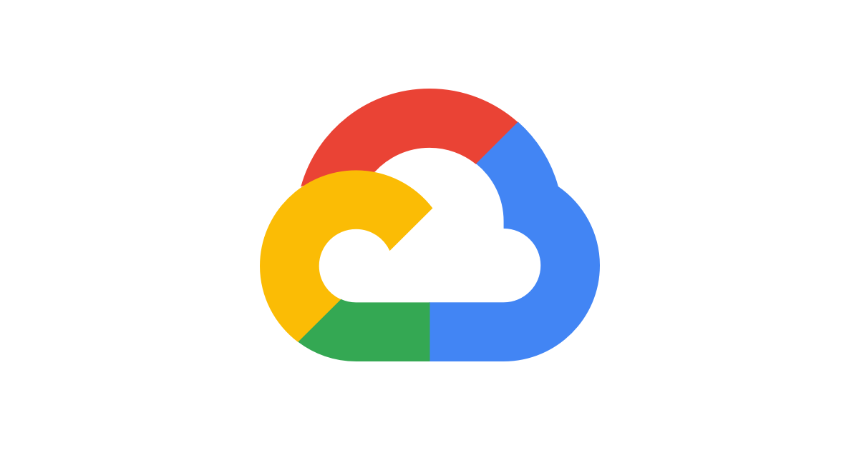
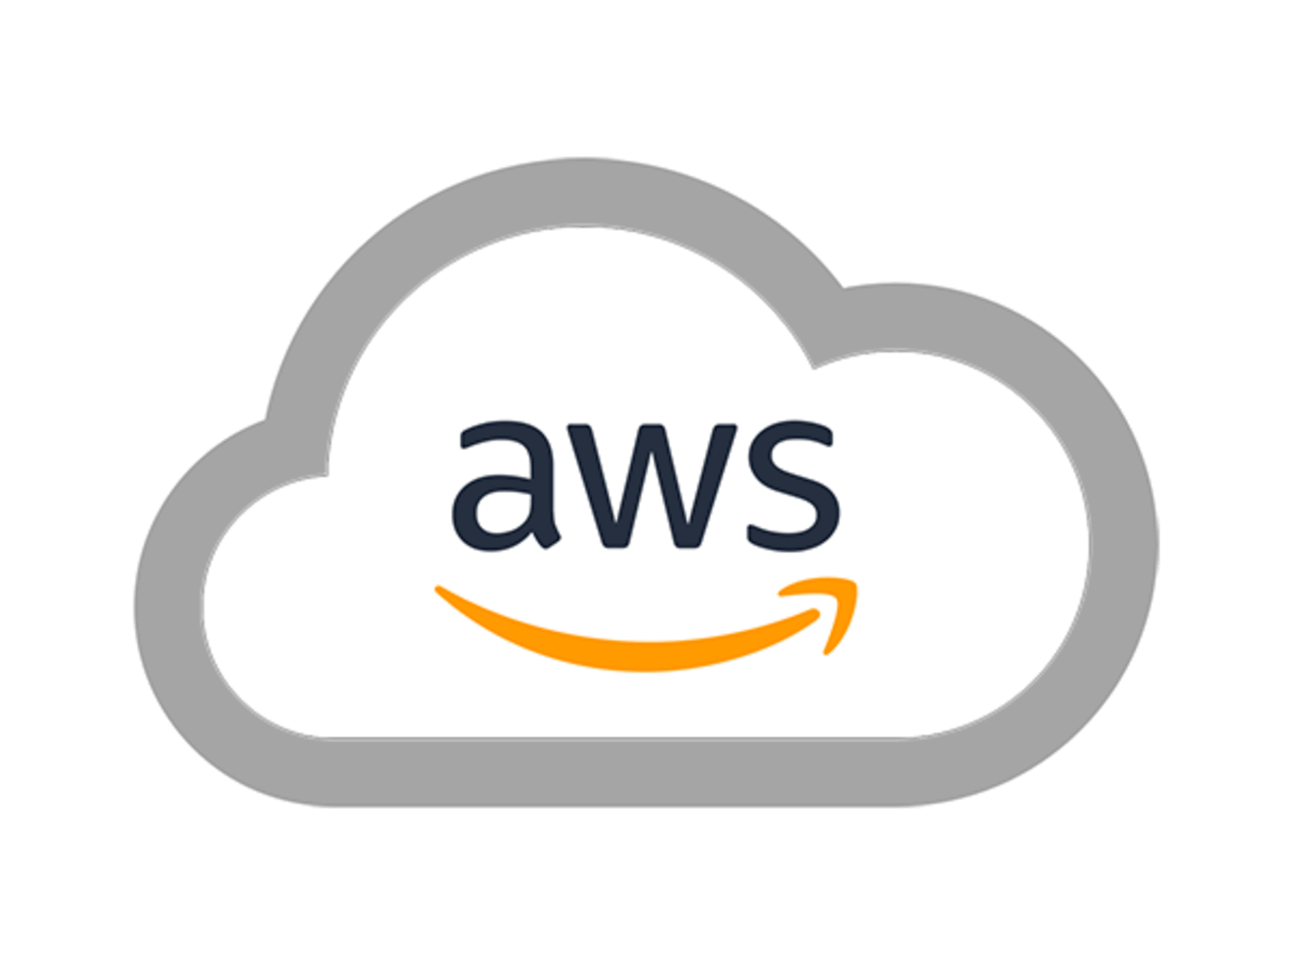
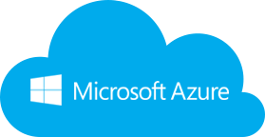



API Gateway (Business)
How does an API Gateway == $$$$$
Notes:
Many companies expose their solutions through APIs Gateways and charge for the use of those APIs or underlying systems. Think about how AWS, Google, and Microsoft host and expose their cloud platforms.
Other companies offer public APIs without charging but may enforce request throttling. Think about how companies like Facebook, Twitter, and Spotify offer public web APIs at no charge.
The API Gateway is an integral part to modern day enterprise applications. It allows companies to build solutions and expose all or part of the system according to their business model.
1

Slide 9
API Gateway (In practice)
Notes:
There are many different ways to implement an API Gateway in your solutions and the different ways are not necessarily mutually exclusive. The Gateway pattern can be layered with one Gateway routing to other gateways and on and on. However this would rarely be the case. Kind of like if you lived in a gated community. The gate to the community gives access to the community, but the gate in your fence gives access to your yard, and your front door gives access to your home and your home exposes all of the "services" of your house.
You could experience Framework gateways, managed gateways, and reverse proxies
1

Slide 10
API Gateway (In practice)
Framework Gateways
Zuul
Ocelot
Hapi
Managed Gateway
AWS API Gateway
GCP Cloud Endpoints
Azure API Management
Tyk
Apigee
Mulesoft
Reverse Proxies
Nginx
Virtually any webserver capable of reverse proxy config
Notes:
Framework Gateways are built closely too and with the underlying services. They tend to focus on a single platform, but often expose a REST API for cross platform usage.
Managed Gateways are provided by a 3rd party and usually have hidden benefits like HA, autoscaling, and load balancing built right into the infrastructure
Reverse Proxies are the most independent. As they aren’t tied to any particular platforms or technologies. They require the most work and must be installed and configured as part of the system.
<number>

Slide 11
API Gateway (In practice)
Bonus Features
Retry Policies
Caching
Authentication
Authorization
Caching
Key Features
API Security
Monitoring and Logging
Rate Limiting
Threat protection
Scaling
Notes:
Framework Gateways are built closely too and with the underlying services. They tend to focus on a single platform, but often expose a REST API for cross platform usage.
Managed Gateways are provided by a 3rd party and usually have hidden benefits like HA, autoscaling, and load balancing built right into the infrastructure
Reverse Proxies are the most independent. As they aren’t tied to any particular platforms or technologies. They require the most work and must be installed and configured as part of the system.
<number>

Slide 12
Let’s get Started

Slide 13
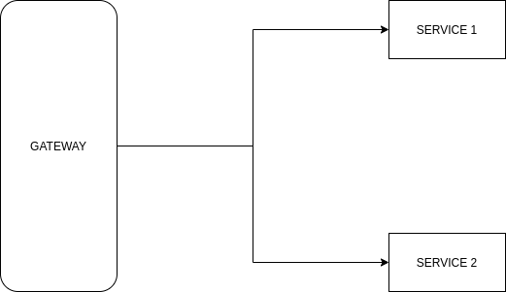
Its Easy
Notes:
In small setups like this it is kind of simple. With single application instances, we are trying to guarantee that the service’s ip will remain constant. We have to ask then is the gateway necessary. Requests could be made directly to the instances, but this is highly unrealistic.

Slide 14
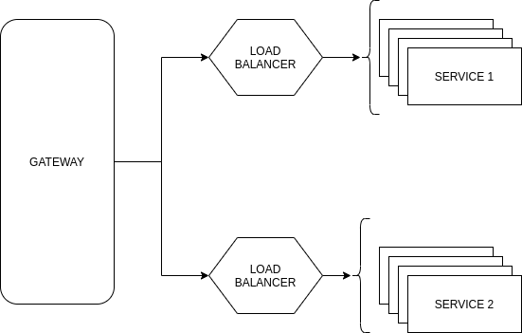
Or Not
Notes:
This is a more practical setup. Aiming for HA and load balancing in the enterprise world. Now however, we can guarantee ip addresses so we will have to rely on the gateway to help us get to the correct service.

Slide 15
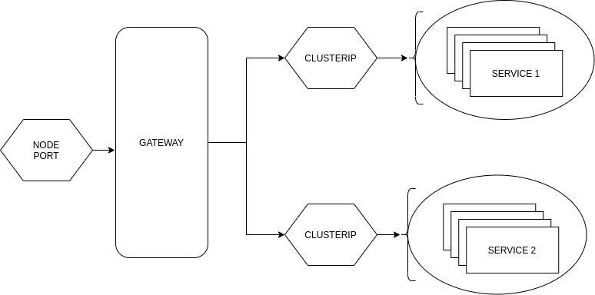
Definitely Not
Notes:
This final setup is the one used in the example. The system is deployed to a Kubernetes cluster which adds a lot of moving parts and without some kind of gateway communicating with the services will be impossible.

